Slide 1

Tranexamic Acid
EMS Educators
May 2024

Slide 2
Objectives and goals
EMS Provider will comprehend the use of TXA.
The EMS Provider will understand the ICEMA protocol requirements for the use of TXA in Trauma and Post Partum Hemorrhage.

Slide 3
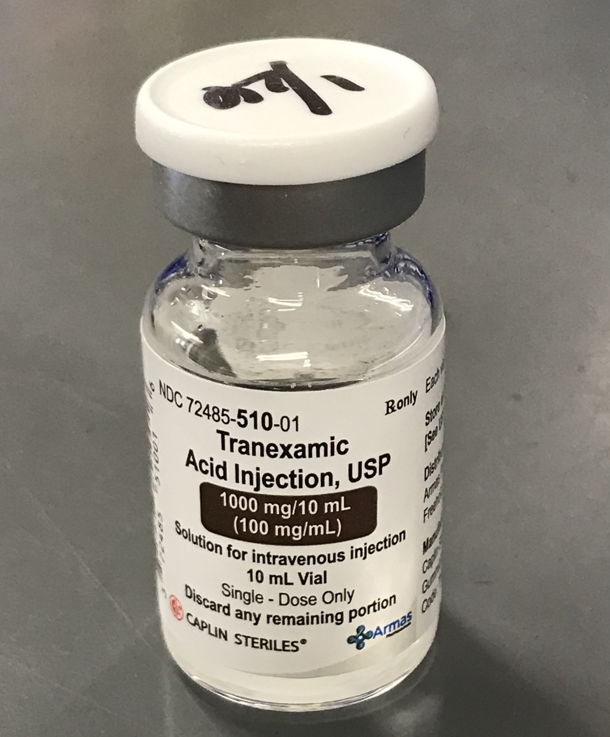
TXA …
Know when it’s indicated

Slide 4
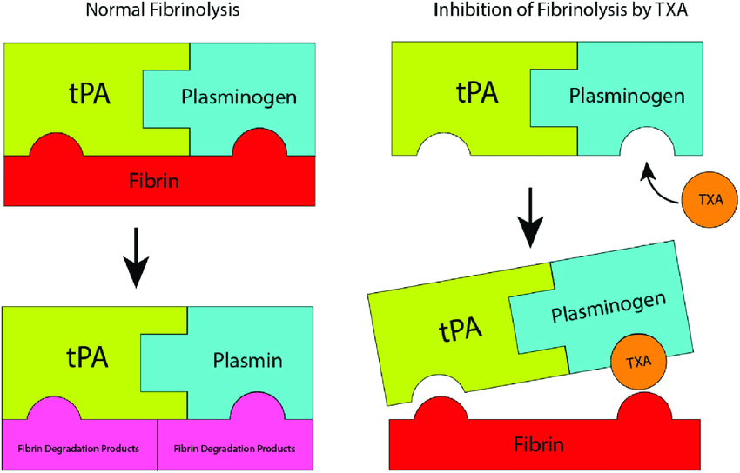
What is it?
TXA (Tranexamic Acid)
It is an Antifibrinolytic that inhibits the activation of plasminogen to plasmin, preventing the breakup of fibrin.

Slide 5
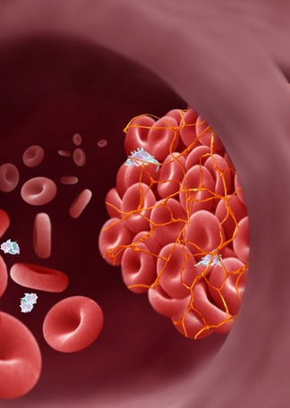
How it works
TXA maintains clot stability by preventing it from dissolving thus stabilizing the clot at the site of bleeding
Don’t POP The Clot!
This Photo by Unknown Author is licensed under CC BY-NC

Slide 6
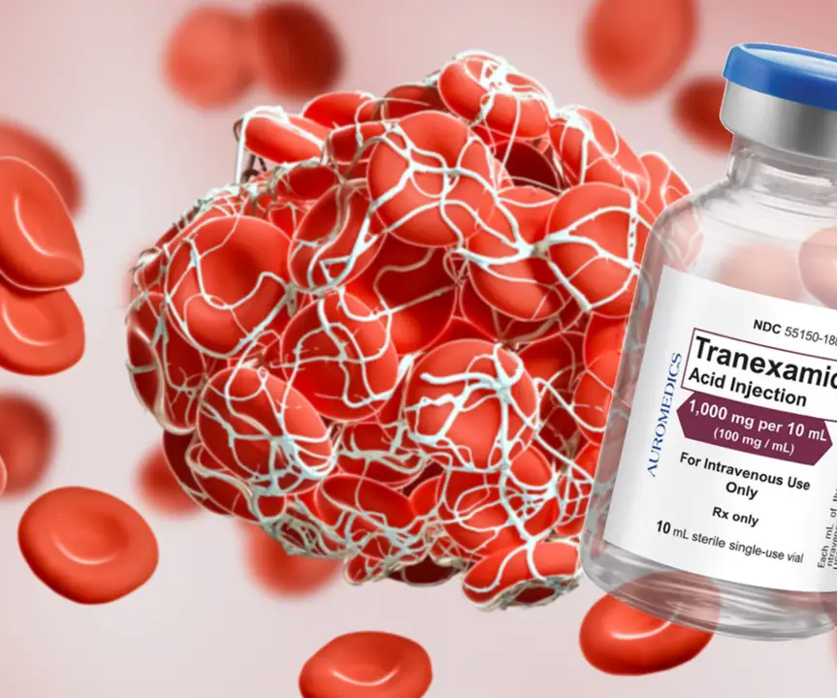
How it works
For TXA to have a therapeutic impact on coagulation pathways, it must be administered within 3 hours after traumatic injury occurs. If it is given after this time frame it can worsen the patient’s condition and outcome. Although it is not fully understood why this happens, Clinical trials have shown worsening outcomes if TXA is administered more than 3 hours after traumatic injury

Slide 7
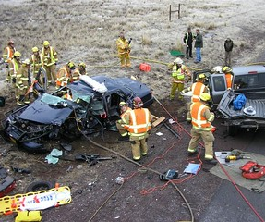
Indications – Trauma
For patients greater than 15 years of age, blunt or penetrating injuries must occur within three (3) hours of injury and must have either:
Signs and symptoms of hemorrhagic shock with SBP less than 90 mm Hg.
Significant hemorrhage with a heart rate greater than or equal to 120.
Bleeding not controlled by direct pressure or tourniquet.
This Photo by Unknown Author is licensed under CC BY

Slide 8
Medication-Standard Orders
Protocol #11010
Signs of hemorrhagic shock meeting inclusion criteria <3 hours post traumatic injury :
Administer TXA 1 gm in 50 - 100 ml of NS via IV/IO over 10 minutes.
Do not administer IVP as this will cause hypotension.

Slide 9
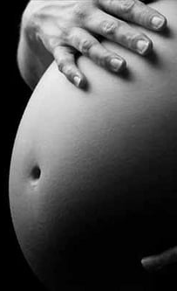
Indications – Post partum Hemorrhage
For postpartum hemorrhage with continued signs of inadequate tissue perfusion, not responsive to fluid challenge within three (3) hours of onset must have either:
Signs and symptoms of hemorrhagic shock with SBP less than 90 mm Hg.
Significant hemorrhage with heart rate greater than or equal to 120.
This Photo by Unknown Author is licensed under CC BY
Notes:
Remind crews – post partum hemorrhage we can do fundal massage to slow the bleeding down, and encourage breastfeeding if possible to promote uterine contractions.

Slide 10
Medications Standard-orders
Protocol #11010
Signs of postpartum hemorrhagic shock (base hospital order only):
Administer TXA 1 gm in 50 - 100 ml of NS via IV/IO over 10 minutes.
Do not administer IVP as this will cause hypotension.

Slide 11
Contraindications – Exclusion Criteria
Any patient less that 15 years old
Any patient more than 3 hours post-injury or onset
Penetrating Cranial injury
Traumatic brain injury with brain matter exposed
Documented cervical spine injury with motor deficits

Slide 12

CASE #1
Penetrating Trauma:
First responders arrive to find a 35-year-old female laying on the floor. Assessment revealed multiple stab wounds to bilateral upper extremities and torso. A large pool of blood (400-500mL) was present, but the patient is not actively bleeding. Skins sign were pale/cool/moist with a pulse of 127; responders were not able to obtain a BP

Slide 13

CASE #2
Uncontrolled Hemorrhage:
Dialysis staff calls 911 for an elderly male, post dialysis treatment. Responders arrive to find active bleeding from a fistula; despite staff attempts to control it. Skin signs were normal with and estimated blood loss of 750mLs. Blood pressure obtained was 136/78 with a heart rate of 88.

Slide 14
CASE #3
Blunt Force Trauma:
First responders arrive at a 2-vehicle TC with major damage. The restrained driver was found unresponsive (GCS 3). Agonal respirations are assisted with manual ventilation, and blood from mouth/nose required suctioning. Assessment revealed abdominal distension and abrasions from the seat belt. Blood pressure obtained was 88/54; heart rate of 132. Skins signs are pale/cool/moist.

Slide 15
CASE #4
Uncontrolled Hemorrhage:
Responders arrive and find a 54 y/o male vomiting blood. 500mLs of bright red emesis is noted as patient is actively vomiting. A blood pressure of 88/76 is obtained with a pulse of 110; Skins signs are Pale/warm/dry.

Slide 16
CASE #5
Postpartum Hemorrhage:
First responders arrive to find a 28-year-old female laying in bed. Patient delivered a full-term infant with the help of a midwife 30 min ago despite fundal massage and breast feeding the infant bleeding continued post delivery. A large pool of blood (400-500mL) was present, and the patient is actively bleeding. Skins sign were pale/cool/moist with a pulse of 132 BP is 84/42. Base hospital contact is made and an order is given for TXA.

Slide 17

Do not administer any medication you did not draw up.
The agency that administered TXA will document in the medication Tab.
Any additional agency that assisted in patient care should document the administration in the narrative.

Slide 18
References
EMS Educators TXA Education August 5, 2021.
ICEMA Protocol Manual 2024
Pictures of the World Wide Web 2024

Slide 19

Thank you
EMS Educators

